Slide 1








Plant disease detection: Yield loss Estimation
REVIEW 3
by
Roll no:-
TC244 : Tejas Naikude
Under the guidance of
Dr. Anita Shinde

Slide 2
Agenda
Introduction
Motivation
Problem Statement
Scope & Objectives
Literature Survey
Software/Hardware required
Proposed System Architecture & Algorithm
Implementation and Result Analysis
Conclusion
Report
References

Slide 3
Introduction
Problem: Crop yield reduces due to diseases, pests, and poor conditions. Traditional manual estimation is slow, inaccurate, and not real-time.
Solution: AI-based methods using deep learning models (CNNs, YOLO) analyze crop images to detect disease severity and estimate yield loss automatically.
Purpose: This technology is used for three main goals:
Automate Crop Disease Detection: Use AI models to automatically detect and classify plant diseases from images.
Estimate Disease Severity and Yield Loss: Accurately measure how much the disease affects crop yield in real time.
Support Informed Decision-Making: Provide reliable data to help farmers take timely actions for disease management and improve crop productivity.

Slide 4
2. Motivation
Problem: Farmers face yield losses due to diseases, pests, and environmental factors, but current estimation methods are manual, slow, and inaccurate.
Why it's important: Accurate yield loss estimation helps improve food security, reduce economic losses, enable early interventions, and support sustainable farming.
Solution: Use AI techniques (CNNs, Transformers, Segmentation) to automatically analyze field images and estimate yield loss in real time, making it fast, cost-effective, and accessible.

Slide 5
3. Problem Statement
Manual methods for estimating crop yield loss caused by diseases and pests are often time-consuming, inaccurate, and costly, resulting in poor decision-making and significant agricultural losses.

Slide 6
4. Scope & Objectives
Scope: Here is a similar style set of points for yield loss estimation:
Develop a system to estimate crop yield loss using AI.
Detect plant diseases and measure their severity.
Apply deep learning and statistical models for prediction.
Evaluate the system for accuracy and practical use in farming.
Objectives:
Analyze disease severity and yield loss relationship
Implement AI/ML-based yield estimation model
Assess deep learning model performance
Validate predictions using field and satellite data
Compare results with traditional estimation methods

Slide 7
5. Literature Survey: Paper 1
Authors: Nidhi Kundu, Geeta Rani, Vijaypal Singh Dhaka, Kalpit Gupta, Siddaiah Chandra Nayaka, Eugenio Vocaturo, Ester Zumpano
Year: November 2022
Title: Disease detection, severity prediction, and crop loss estimation in Maize Crop using deep learning.
Methodology: A convolutional neural network (CNN) model was trained on labeled images of maize leaves to detect disease type and severity, and estimate crop loss, followed by visualization of key features using Grad-CAM.
Key Findings:
Real-life Dataset
Feature Visualization (Grad-CAM).
Limitations:
Lack of Generalization.
Limited Severity Prediction Techniques.

Slide 8
5. Literature Survey: Paper 2
Authors: Muhammad Ashfaq, Muhammad Usman Tariq, Imran Khan, Abdul Rahman Alzahrani, Humera Khan and Anwar Ghani.
Year: March 2024
Title: Accurate Wheat Yield Prediction Using Machine Learning and Climate-NDVI Data Fusion.
Methodology: Multiple machine learning algorithms (SVM, Random Forest, LASSO) were applied to fused satellite NDVI and climate data, with hyperparameter optimization, to predict wheat yield per region in Pakistan.
Key Findings:
High Performance (R²: 0.74–0.88).
Robust Against Climate Variability.
Limitations:
Dependent on Data Quality.
Black-box ML Models.

Slide 9
5. Literature Survey: Paper 3
Authors: Muhammad Rizwan, Khokher Changming Sun, Qiyu Liao, Adam L.Smith, Donald Mackenize, Mark R. Thomas, Dadong Wang, and Everard J. Edwards
Year: March 2023
Title: Early Yield Estimation in Viticulture Based on Grapevine Inflorescence Detection and Counting in Videos
Methodology: A custom video dataset was collected and a deep learning object detection model (YOLOv5) was used to detect and count grape vine inflorescences during early growth stages for predicting yield.
Key Findings:
Early Stage Prediction (E-L 12 stage).
High Accuracy in Detection (80% Precision, 83% Recall).
Limitations:
High Annotation Effort.
Error in Yield Estimation (4–11%).

Slide 10
5. Literature Survey: Paper 4
Authors: Fumin Wang , Jiale Li , Dailiang Peng , Qiuxiang Yi, Xiaoyang Zhang, Jueyi Zheng, and Siting Chen
Year: July 2024
Title: Estimating Soybean Yields Using Causal Inference and Deep Learning Approaches With Satellite Remote Sensing Data
Methodology: Causal relationships between variables were modeled using a Structural Causal Model (SCM) integrated into a Graph Attention Network (GAT), enabling soybean yield prediction from satellite remote sensing and weather data.
Key Findings:
Causal Relationship Integration.
Superior Performance over Baselines.
Limitations:
High Computational Complexity.
Limited Generalizability to Other Crops.

Slide 11
5. Literature Survey: Paper 5
Authors: Kathirvel Narayanasamy and Ilayaraja Venkatachalam.
Year: June 2025
Title: Predicting Sugar Yield From Sugarcane Using Machine Learning for Jaggery Production.
Methodology: Random Forest and other regression models were trained on a dataset of sugarcane physicochemical properties and environmental factors, using SHAP and Lasso for feature interpretation and hyperparameter tuning for optimal performance.
Key Findings:
High Predictive Accuracy (R² = 0.9503).
Practical Implications for Jaggery Industry .
Limitations:
Reduced Accuracy at High Yield Values (>120 kg/ton).
Potential for data imbalance.

Slide 12
5. Literature Survey
Sr. No | Author(s) & Year | Title of Paper | Methodology | Key Findings | Limitations
1 | Nidhi Kundu, Geeta Rani, Vijaypal Singh Dhaka, Kalpit Gupta, Siddaiah Chandra Nayaka, Eugenio Vocaturo, Ester Zumpano November 2022 | Disease detection, severity prediction, and crop loss estimation in Maize Crop using deep learning. | A convolutional neural network (CNN) model was trained on labeled images of maize leaves to detect disease type and severity, and estimate crop loss, followed by visualization of key features using Grad-CAM. | High Accuracy (98.5%) Real-life Dataset Integrated Web Application Feature Visualization (Grad-CAM) Low Training Time | Lack of Generalization Complex Background Handling. Limited Severity Prediction Techniques Hardware Requirements Assumes Full Data Availability
2 | Muhammad Ashfaq, Muhammad Usman Tariq, Imran Khan, Abdul Rahman Alzahrani, Humera Khan and Anwar Ghani. March 2024 | Accurate Wheat Yield Prediction Using Machine Learning and Climate-NDVI Data Fusion. | Multiple machine learning algorithms (SVM, Random Forest, LASSO) were applied to fused satellite NDVI and climate data, with hyperparameter optimization, to predict wheat yield per region in Pakistan. | High Performance (R²: 0.74–0.88) Multiple ML Algorithms Compared Public Data Integration Incorporation of Soil & Spatial Data Robust Against Climate Variability | Dependent on Data Quality Black-box ML Models Geographically Limited Study Limited Model Comparisons Feature Selection Complexity
3 | Muhammad Rizwan, Khokher Changming Sun, Qiyu Liao, Adam L.Smith, Donald Mackenize, Mark R. Thomas, Dadong Wang, and Everard J. Edwards March 2023 | Early Yield Estimation in Viticulture Based on Grapevine Inflorescence Detection and Counting in Videos | A custom video dataset was collected and a deep learning object detection model (YOLOv5) was used to detect and count grapevine inflorescences during early growth stages for predicting yield. | Early Stage Prediction Custom Dataset Collected High Accuracy in Detection On-the-Go Measurements Non-destructive & Contactless | Moderate Precision & Recall (80%) High Annotation Effort Specialized Hardware Setup Limited Dataset Variety Error in Yield Estimation (4–11%)

Slide 13
5. Literature Survey
Sr. No | Author(s) & Year | Title of Paper | Methodology | Key Findings | Limitations
4 | Fumin Wang , Jiale Li , Dailiang Peng , Qiuxiang Yi, Xiaoyang Zhang, Jueyi Zheng, and Siting Chen July 2024 | Estimating Soybean Yields Using Causal Inference and Deep Learning Approaches With Satellite Remote Sensing Data | Causal relationships between variables were modeled using a Structural Causal Model (SCM) integrated into a Graph Attention Network (GAT), enabling soybean yield prediction from satellite remote sensing and weather data. | Causal Relationship Integration Superior Performance over Baselines Better Extreme Condition Performance Identification of Key Growth Phases Structural Causal Model (SCM) | High Computational Complexity Limited Generalizability to Other Crops Requires Domain Knowledge for Causal Graph Limited to County-level Prediction Heavy Data Dependency
5 | Kathirvel Narayanasamy and Ilayaraja Venkatachalam. June 2025 | Predicting Sugar Yield From Sugarcane Using Machine Learning for Jaggery Production. | Random Forest and other regression models were trained on a dataset of sugarcane physicochemical properties and environmental factors, using SHAP and Lasso for feature interpretation and hyperparameter tuning for optimal performance. | High Predictive Accuracy (R² = 0.9503) Direct Sugar Yield Prediction (kg/ton) Interpretable Model with SHAP and Lasso Robust Dataset from Real-World Sources Practical Implications for Jaggery Industry | Reduced Accuracy at High Yield Values (>120 kg/ton) Limited Geographic Generalizability Minimal Contribution of Environmental Factors (<5%) No Real-Time Deployment Yet Limited to Sugar Yield Prediction Only

Slide 14
6. Software/Hardware required
💻Software Requirements:-
OS: Windows 10 / 11 or Ubuntu 20.04+
Frontend: HTML5, CSS3, JavaScript
Backend: Python 3.8(Flask, Django, etc)
Chart Library: Chart.js (for yield visualization)
IDE/Editor: VS Code or Sublime Text
Browser: Chrome / Edge (latest version)
🖥️Hardware Requirements:-
Processor: Intel i3 (7th Gen) or higher
RAM: Minimum 4 GB (8 GB recommended)
Storage: 10 GB free disk space (SSD preferred)
Display: 1366×768 px or higher resolution
GPU (Optional): NVIDIA GTX 1050 Ti + (for ML model training)

Slide 15
7. Proposed System Architecture & Algorithm
Step 1: Data Acquisition:-
User uploads relevant crop and environmental data (e.g., soil type, rainfall, temperature, fertilizer usage, and crop images) through the frontend interface.
The system sends this input to the backend server for processing.
Step 2: Data Preprocessing:-
Collected data is cleaned, normalized, and formatted.
Handle missing or inconsistent values.
Resize and enhance crop images if used.
Convert categorical and numerical features into model-compatible formats.
Step 3: Feature Extraction:-
Extract key parameters that influence yield, such as:
Crop health indices (NDVI, leaf area, color, etc.)
Environmental factors (rainfall, temperature, humidity)
Soil properties (moisture, nutrients, pH)
These features are then passed to the model for analysis.

Slide 16
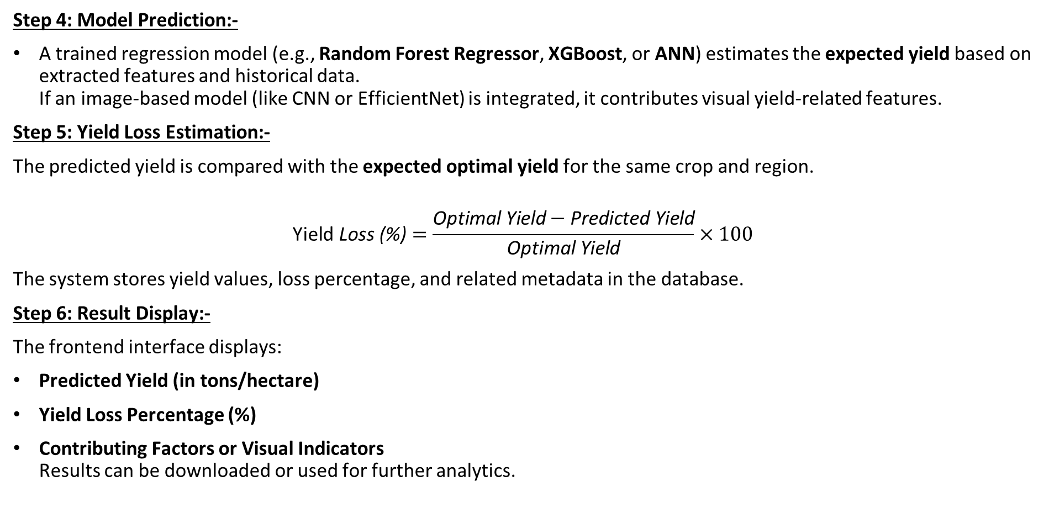
7. Proposed System Architecture & Algorithm
Step 4: Model Prediction:-
A trained regression model (e.g., Random Forest Regressor, XGBoost, or ANN) estimates the expected yield based on extracted features and historical data.
If an image-based model (like CNN or EfficientNet) is integrated, it contributes visual yield-related features.
Step 5: Yield Loss Estimation:-
The predicted yield is compared with the expected optimal yield for the same crop and region.
$$\text{Yield} \text{Loss}\text{ (\%)}=\frac{\text{Optimal} \text{Yield}−\text{Predicted} \text{Yield}}{\text{Optimal} \text{Yield}}×100$$
The system stores yield values, loss percentage, and related metadata in the database.
Step 6: Result Display:-
The frontend interface displays:
Predicted Yield (in tons/hectare)
Yield Loss Percentage (%)
Contributing Factors or Visual Indicators
Results can be downloaded or used for further analytics.

Slide 17
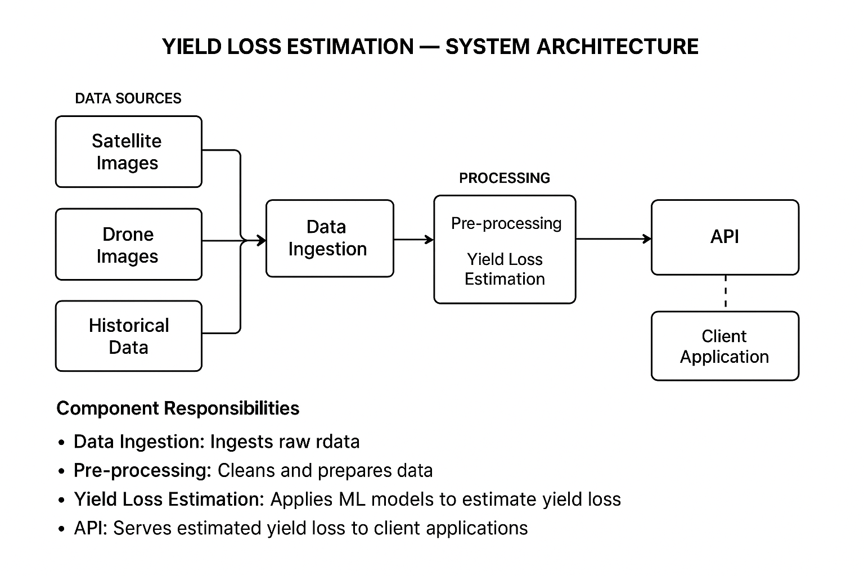
7. Proposed System Architecture & Algorithm

Slide 18
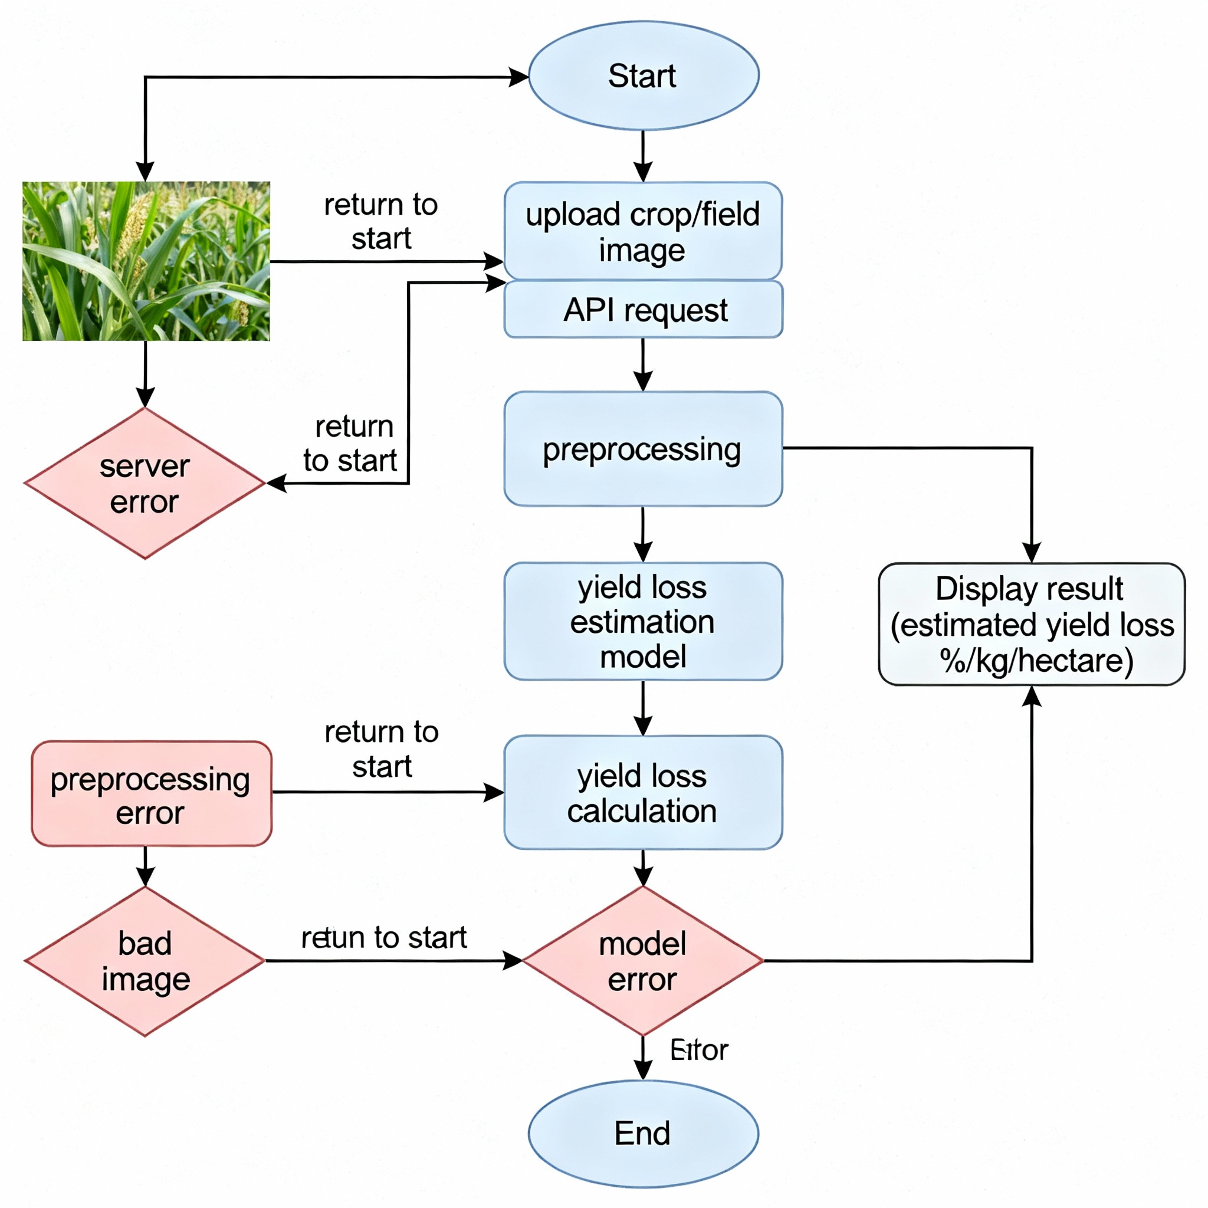
7. Proposed System Architecture & Algorithm

Slide 19
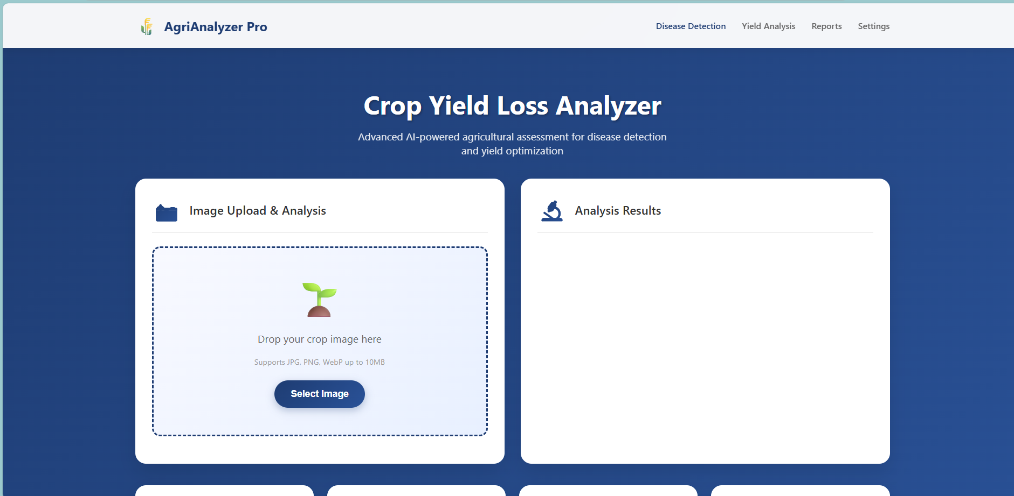
8. Implementation and result analysis

Slide 20
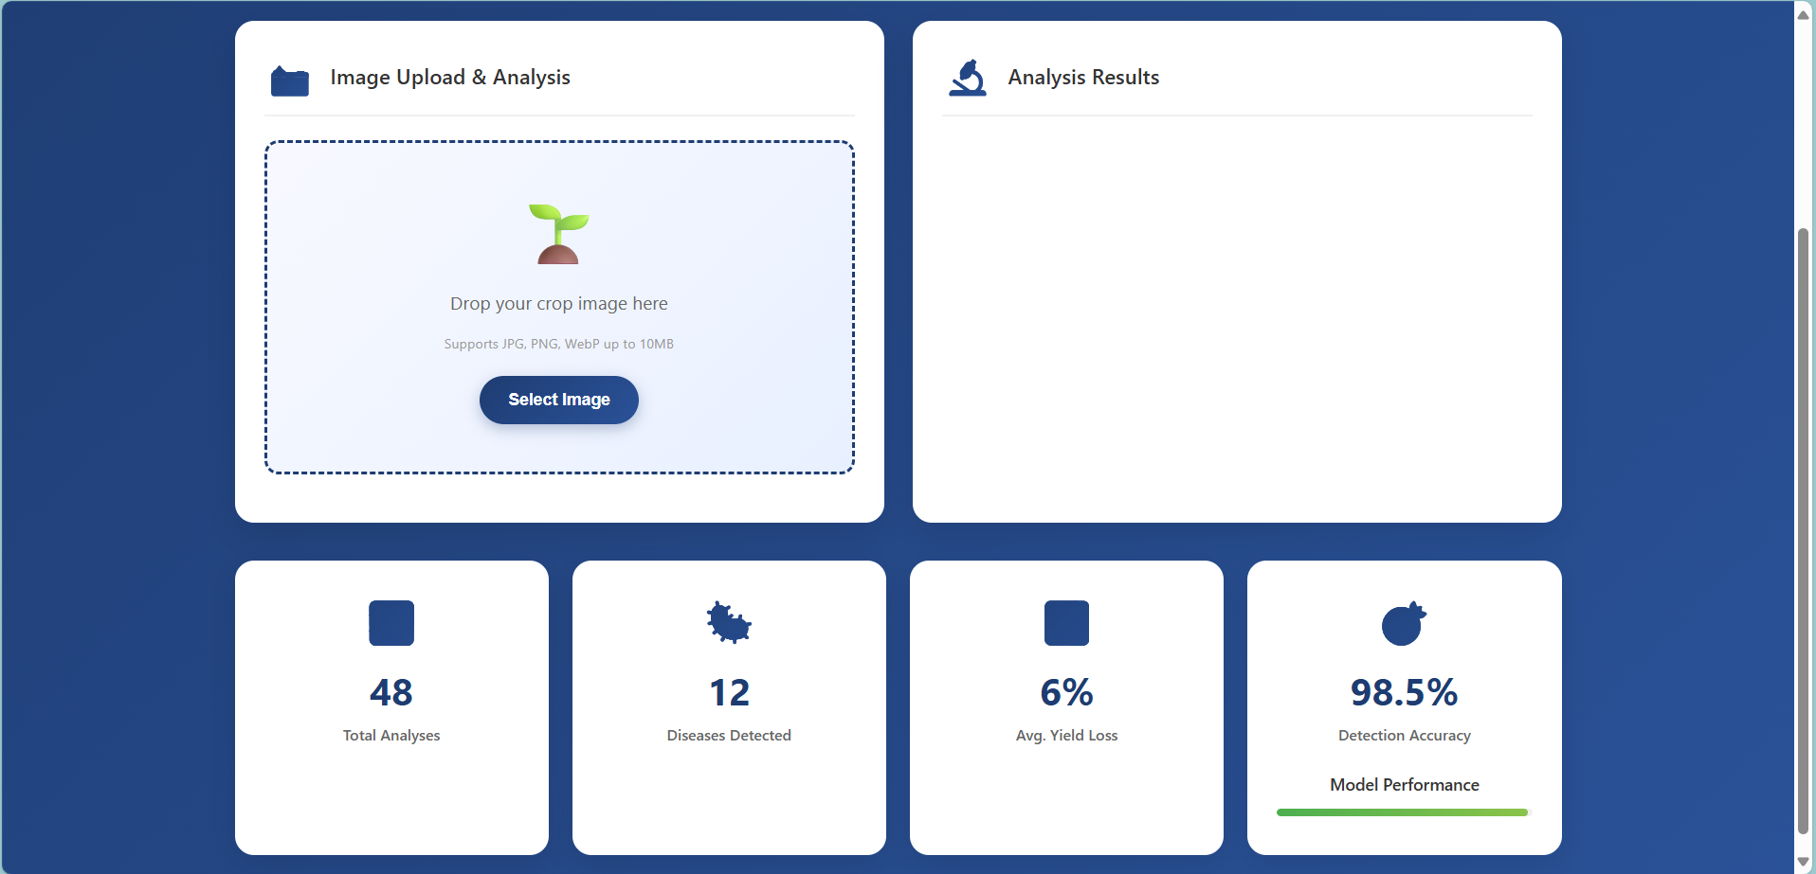
8. Implementation and result analysis

Slide 21
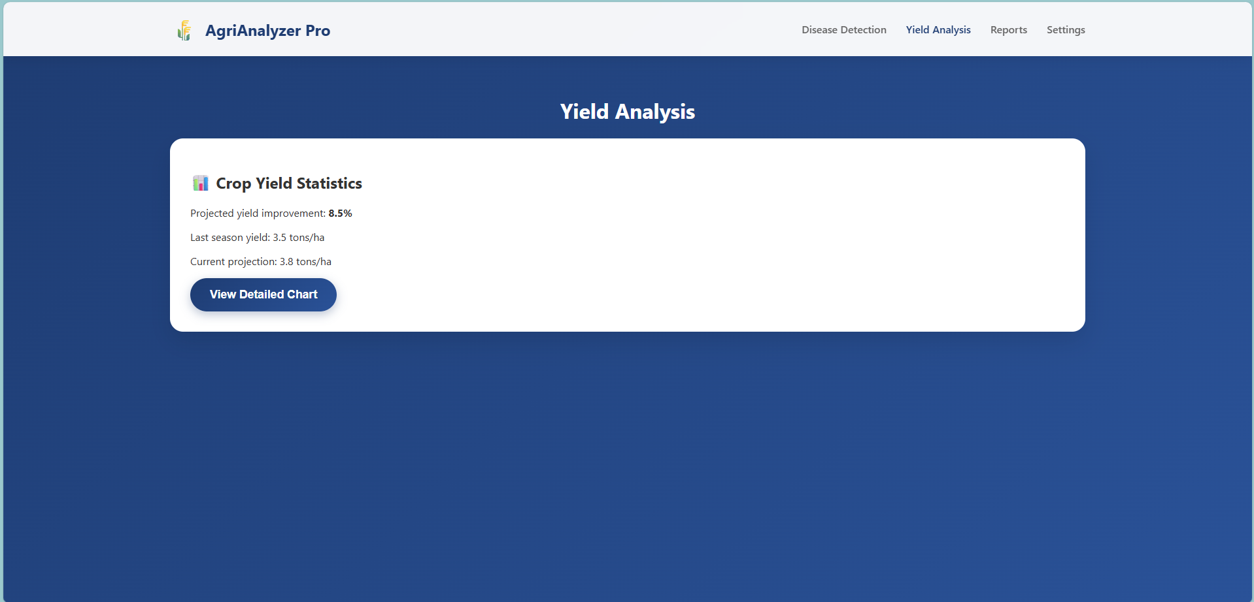
8. Implementation and result analysis

Slide 22

8. Implementation and result analysis

Slide 23
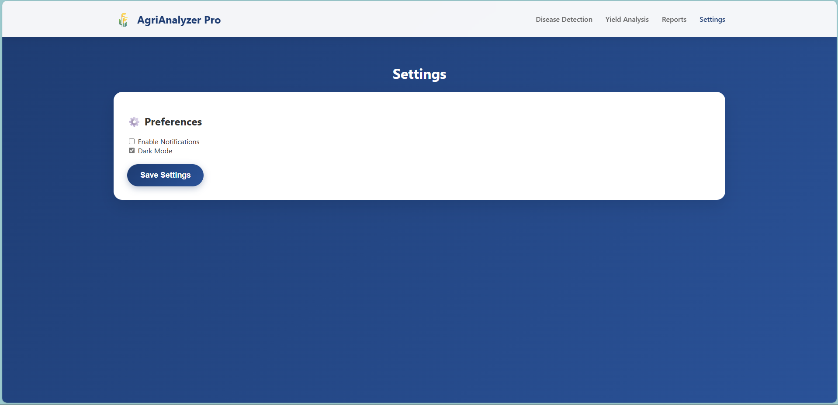
8. Implementation and result analysis

Slide 24
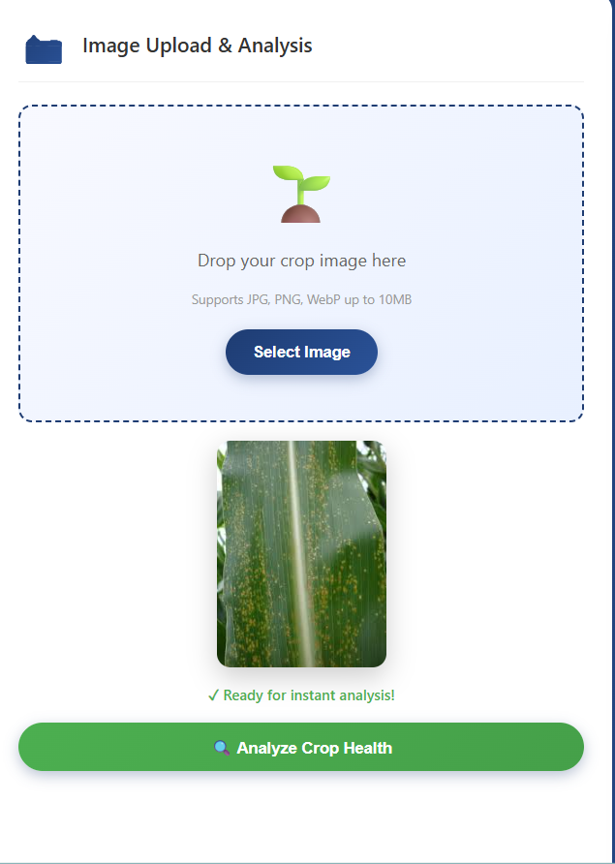
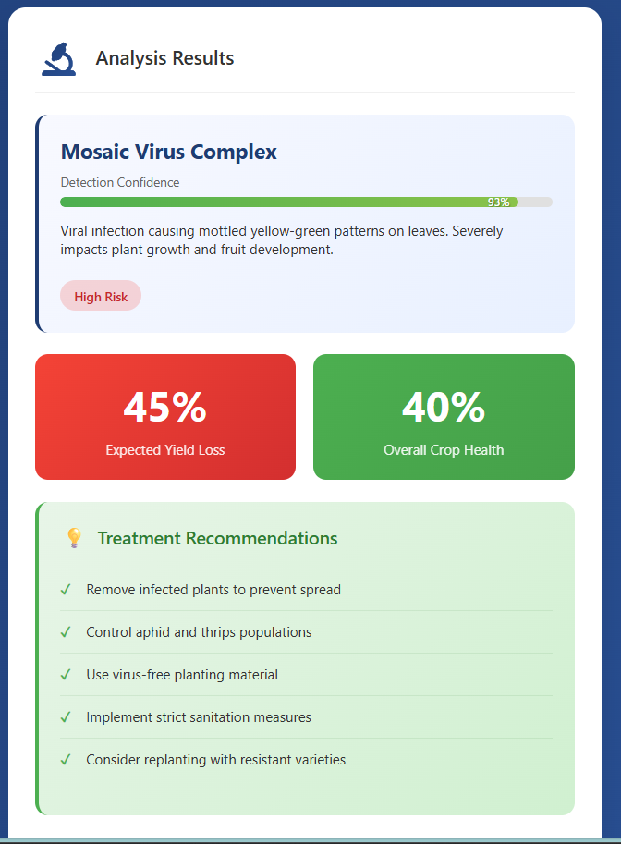
8. Implementation and result analysis

Slide 25
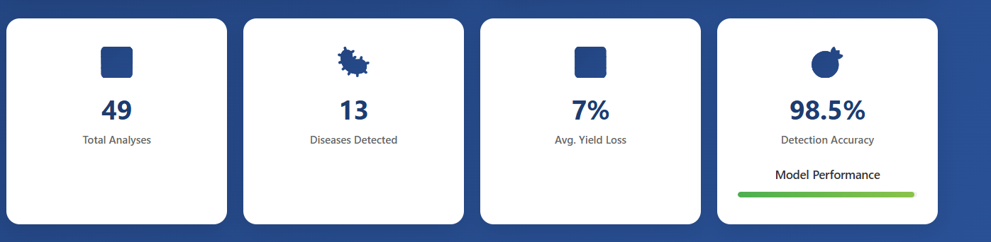
8. Implementation and result analysis

Slide 26
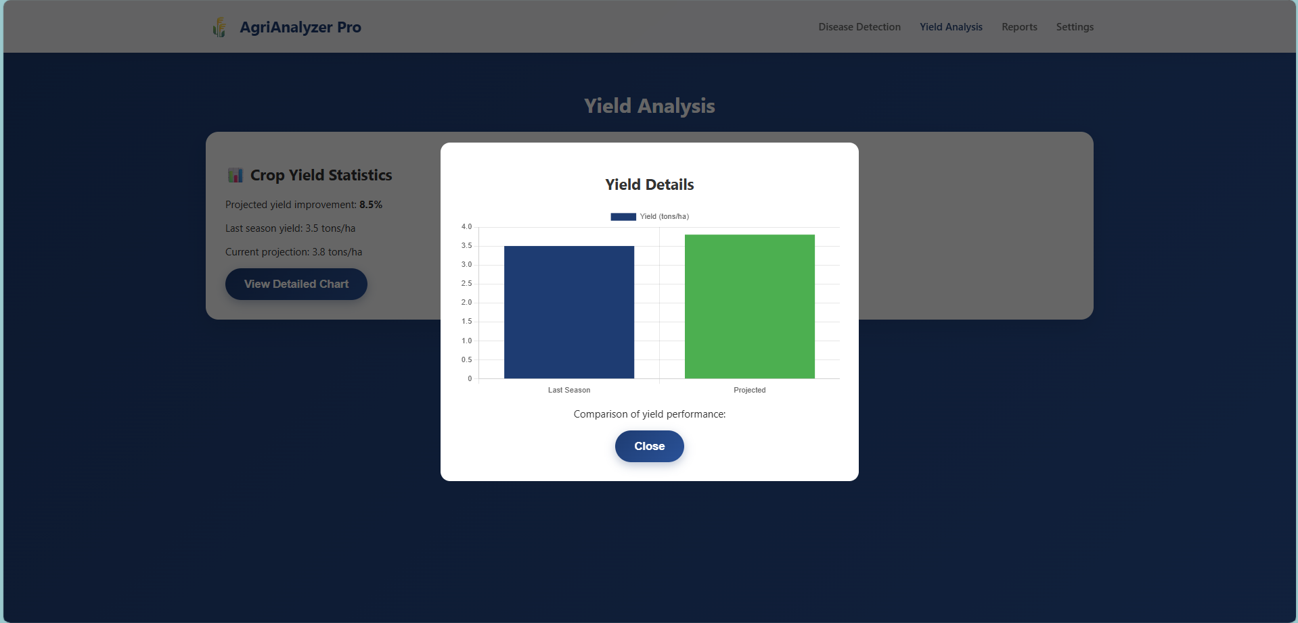
8. Implementation and result analysis

Slide 27
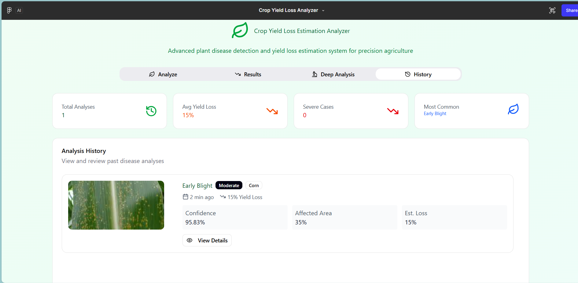
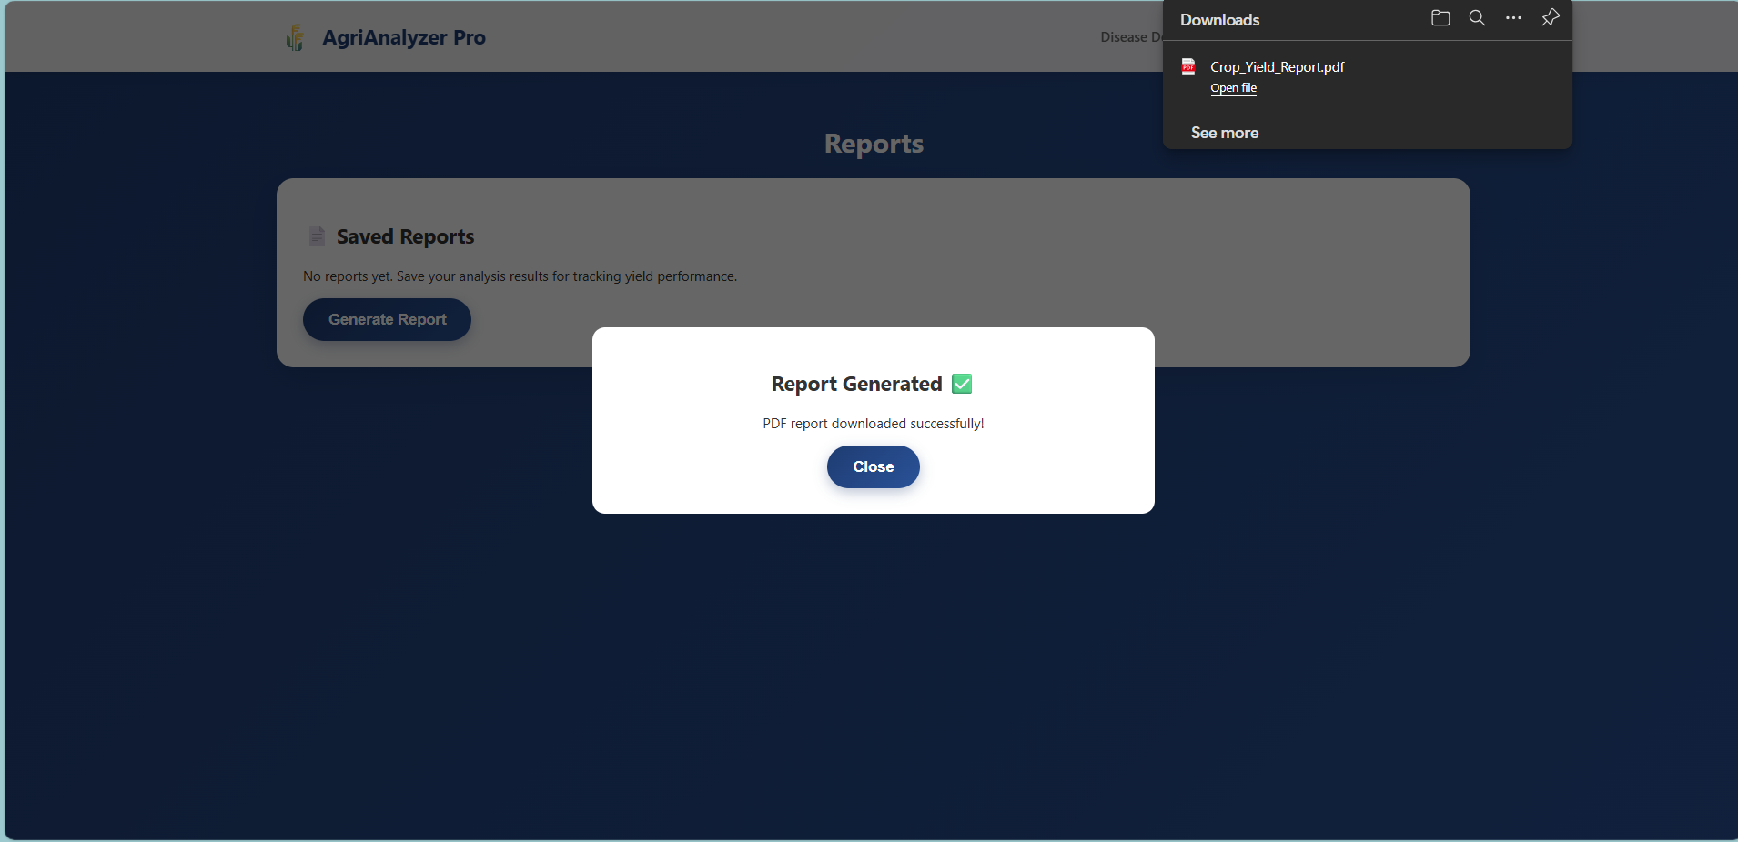
8. Implementation and result analysis

Slide 28
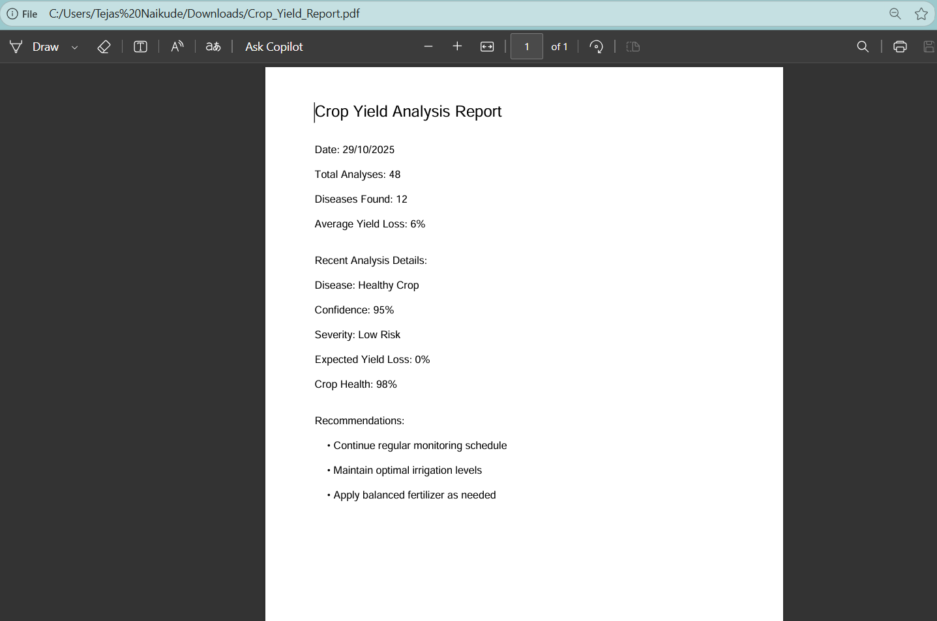
8. Implementation and result analysis

Slide 29
Conclusion
Module 3 focused on estimating crop yield loss using deep learning. Methods like CNN and YOLO effectively detect and classify plant diseases from leaf images. However, challenges like limited generalization and complex hardware persist. Our goal is to develop an accurate, cost-effective solution for real-world farming.

Slide 30
8. References
Kundu, N., Rani, G., Dhaka, V. S., Gupta, K., Nayaka, S. C., Vocaturo, E., & Zumpano, E. (2022). Disease detection, severity prediction, and crop loss estimation in maize crop using deep learning.
Ashfaq, M., Tariq, M. U., Khan, I., Alzahrani, A. R., Khan, H., & Ghani, A. (2024). Accurate wheat yield prediction using machine learning and climate-NDVI data fusion.
Rizwan, M., Sun, K. C., Liao, Q., Smith, A. L., Mackenzie, D., Thomas, M. R., Wang, D., & Edwards, E. J. (2023). Early yield estimation in viticulture based on grapevine inflorescence detection and counting in videos.
Wang, F., Li, J., Peng, D., Yi, Q., Zhang, X., Zheng, J., & Chen, S. (2024). Estimating soybean yields using causal inference and deep learning approaches with satellite remote sensing data.
Narayanasamy, K., & Venkatachalam, I. (2025). Predicting sugar yield from sugarcane using machine learning for jaggery production.
Mohanty, S. P., Hughes, D. P., & Salathé, M. (2016). Using deep learning for image-based plant disease detection. Frontiers in Plant Science, 7, 1419.
Sladojevic, S., Arsenovic, M., Anderla, A., Culibrk, D., & Stefanovic, D. (2016). Deep neural networks based recognition of plant diseases by leaf image classification. Computational Intelligence and Neuroscience, 2016.
Ferentinos, K. P. (2018). Deep learning models for plant disease detection and diagnosis. Computers and Electronics in Agriculture, 145, 311–318.

Slide 31
8. References
Barbedo, J. G. A. (2013). Digital image processing techniques for detecting, quantifying and classifying plant diseases. SpringerPlus, 2(1), 660.
Ramcharan, A., McCloskey, P., Baranowski, K., et al. (2017). Deep learning for image-based cassava disease detection. Frontiers in Plant Science, 8, 1852.
Picon, A., Alvarez-Gila, A., Seitz, M., Ortiz-Barredo, A., Echazarra, J., & Johannes, A. (2019). Crop disease classification using deep learning and field images in real-life conditions. Computers and Electronics in Agriculture, 167, 105–119.
Singh, V., & Misra, A. K. (2017). Detection of plant leaf diseases using image segmentation and soft computing techniques. Information Processing in Agriculture, 4(1), 41–49.
Too, E. C., Yujian, L., Njuki, S., & Yingchun, L. (2019). A comparative study of fine-tuning deep learning models for plant disease identification. Computers and Electronics in Agriculture, 161, 272–279.
Brahimi, M., Boukhalfa, K., & Moussaoui, A. (2017). Deep learning for tomato diseases: Classification and symptoms visualization. Applied Artificial Intelligence, 31(4), 299–315.
Xie, C., & Yang, C. (2020). A review on plant disease identification based on deep learning models. Frontiers in Plant Science, 11, 416.

